Slide 1
SWOT Analysis Case Study – TechMaRT AND 3RD IT STUDENT
https://www.youtube.com/watch?v=1tCcUsncXpE
https://www.youtube.com/watch?v=w2UJxgAvJaU

Slide 2
SWOT Analysis Case Study - Third-Year IT Student

Slide 3
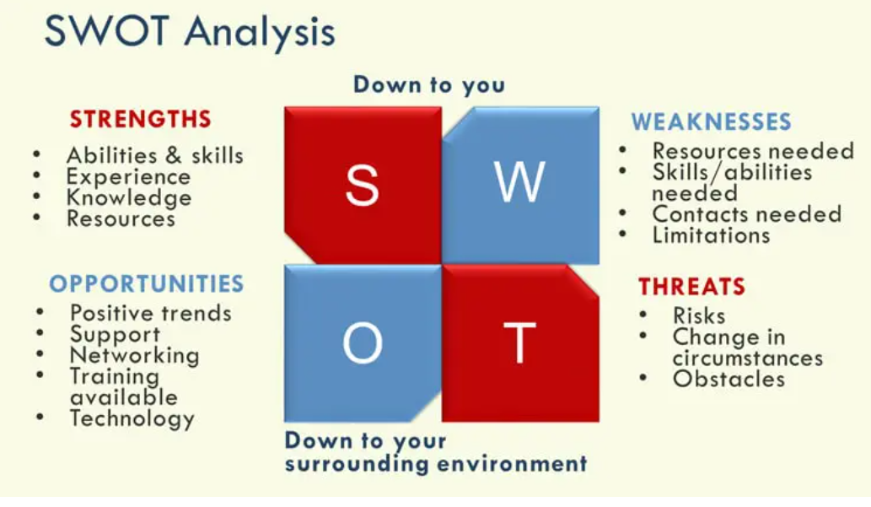

Slide 4

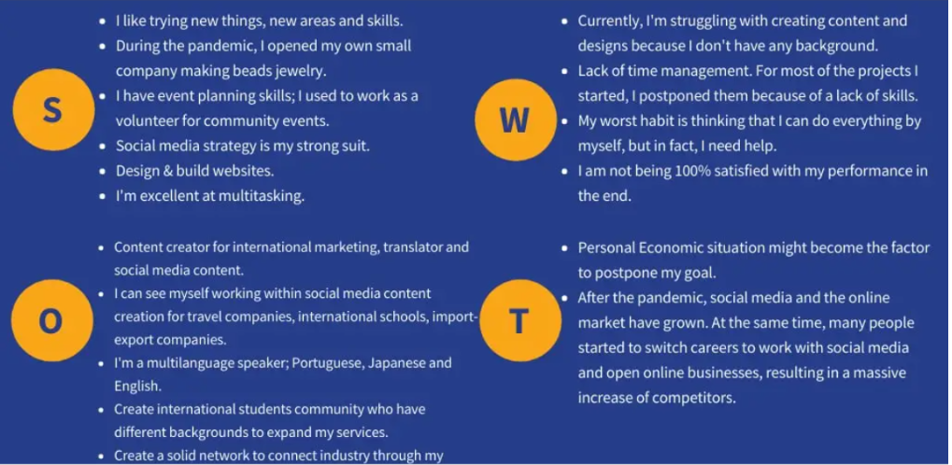

Slide 5
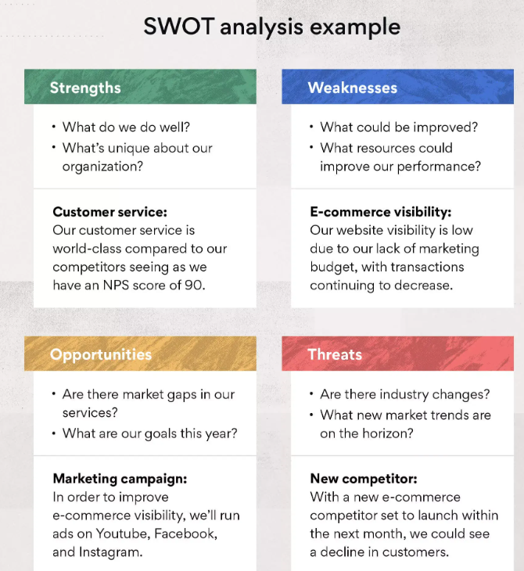

Slide 6
Personal SWOT Analysis Example – Student University

Slide 7
Strengths
• Access to top-tier resources: World-class professors, research labs, and academic libraries.
• Network of professionals: Vast alumni network offering mentorship and internship opportunities.
• Problem-solving skills: Developed through a rigorous curriculum.
• Innovative mindset: Exposure to Silicon Valley’s culture of innovation.

Slide 8
Weaknesses
• Work-life balance: Difficult to balance studies, personal life, and extracurriculars.
• Imposter syndrome: Self-doubt from being surrounded by highly accomplished peers.
• Public speaking anxiety: Lack of confidence when presenting in front of large groups.

Slide 9
Opportunities
• Start-up ecosystem: Proximity to Silicon Valley for collaboration and business opportunities.
• Research opportunities: Access to cutting-edge research labs for groundbreaking work.
• Networking events: Seminars, guest lectures, and career fairs with industry leaders.
• Diverse student body: Expand global perspective through interactions with diverse peers.

Slide 10
Threats
• Competition: High academic competition among students.
• Economic uncertainty: Job market changes could affect post-graduation opportunities.
• Burnout: The high-pressure environment may lead to physical or mental fatigue.

Slide 11
Strengths (2 Marks)
1. Strong Technical Knowledge: Solid understanding of core IT subjects like programming, databases, and networking.
2. Problem-Solving Skills: Exposure to projects and assignments that hone problem-solving abilities.
3. Adaptability: Ability to learn new technologies and programming languages quickly due to IT curriculum.

Slide 12
Weaknesses (2 Marks)
1. Limited Practical Experience: Focus is often on theory rather than hands-on experience in real-world projects.
2. Time Management Challenges: Balancing coursework, projects, and extracurricular activities can be difficult.
3. Lack of Soft Skills: More attention is given to technical skills, leaving communication and teamwork underdeveloped.

Slide 13
Opportunities (2 Marks)
1. Internships: Opportunities to gain practical experience through internships and industry collaborations.
2. Certifications: Obtaining IT certifications (e.g., AWS, Cisco) can enhance employability.
3. Technology Advancements: Rapidly growing IT industry provides numerous chances for specialization and innovation.

Slide 14
Threats (2 Marks)
1. High Competition: The IT field is highly competitive, with many students vying for the same job opportunities.
2. Rapid Technological Changes: Constant updates in technology may render some skills obsolete quickly.
3. Economic Uncertainty: Fluctuations in the job market and economic downturns can impact job prospects.

Slide 15
Conclusion (2 Marks)
A third-year IT student has strong technical knowledge and problem-solving skills. To become more competitive, they should focus on gaining practical experience through internships and improving their soft skills.
Opportunities in the IT field are abundant, but students must keep pace with technological advancements while preparing for the competitive job market.

Slide 16
TechMaRT Strengths (2 Marks)
1. Strong Brand Presence: Loyal customer base from physical stores.
2. Diverse Product Range: Wide variety of electronics appeals to many customers.
3. Experienced Workforce: Skilled employees providing excellent customer service.

Slide 17
Weaknesses (2 Marks)
1. Limited Online Presence: Slow to establish a strong e-commerce platform.
2. Higher Operating Costs: Running physical stores leads to higher overhead costs.
3. Outdated Technology Infrastructure: Inefficient internal systems.

Slide 18
Opportunities (2 Marks)
1. E-commerce Expansion: Opportunity to boost revenue through online sales.
2. Omnichannel Integration: Combining online and in-store shopping for a seamless experience.
3. Partnerships: Collaboration with suppliers to reduce costs and improve efficiency.

Slide 19
Threats (2 Marks)
1. Increasing Online Competition: Online competitors offering lower prices.
2. Economic Downturn: Potential reduction in consumer spending.
3. Technological Changes: Rapid advancements could render products obsolete.

Slide 20
Conclusion (2 Marks)
Based on the SWOT analysis, TechMart can leverage its strengths such as brand loyalty and product range to build an effective online presence. By addressing its weaknesses in technology, TechMart can become more competitive.
The key opportunities lie in e-commerce expansion and partnerships, but vigilance is required to face growing competition and economic factors.

Slide 21
SWOT Analysis Case Study - AI Assistant

Slide 22
Strengths (2 Marks)
1. Comprehensive Knowledge Base: Access to vast information across various fields.
2. 24/7 Availability: Always available for assistance without time constraints.
3. Adaptability: Able to assist with a wide range of tasks across formats.

Slide 23
Weaknesses (2 Marks)
1. Limited Emotional Understanding: Can’t fully comprehend complex emotions.
2. No Real-Time Learning: Frozen knowledge and unable to learn from real-time events.
3. Lack of Original Thought: Responses based on existing data, not true innovation.

Slide 24
Opportunities (2 Marks)
1. Continuous Improvement: Evolving technology can enhance functionality.
2. Integration with Tools: Opportunities to connect with more external tools.
3. Increased Usage in Professional Sectors: More applications in healthcare, finance, etc.

Slide 25
Threats (2 Marks)
1. Competition from Advanced AI: New models may outperform existing capabilities.
2. Ethical Concerns: AI usage could be limited due to privacy or job displacement fears.
3. Regulatory Challenges: AI regulations may limit functionality in certain sectors.

Slide 26
Conclusion (2 Marks)
I have the potential to remain valuable by leveraging my strengths, such as my knowledge base and adaptability. Addressing my weaknesses in real-time learning and emotional intelligence will be crucial.
Staying competitive will require vigilance against new AI models and adherence to ethical standards.

